Slide 1
Data Architect
Role Definition

Slide 2
Data Architect Definition & Purpose
A Data Architect is a senior analyst responsible for ensuring an organization’s data is properly managed.
The scope of a Data Architect’s work will vary depending upon their assignment and may include anything from the entire corporation to a single business unit.
The responsibilities of a Data Architect will also vary depending upon their assignment and may include anything from setting strategies to supporting individual implementations.
The Data Architect is expected to have knowledge in all data management areas, but may specialize in a few of these areas.
The Data Architect must collaborate effectively with multiple stakeholders across the organization to align the data architecture with other architectures and practices at Cargill.
Notes:
Following slides will expand on each one of the highlighted words.

Slide 3
Data Architect Organizational Scope
Cargill is a very large organization with a complex organizational structure.
Cargill owns many different companies bundled together into multiple Enterprises: Cargill Agricultural Supply Chain (CASC), Cargill Animal Nutrition (CAN), Food Ingredient & Bio-Industrial (FIBI), Cargill Protein & Salt (CPS)
Cargill has a presence in over 70 countries around the world. These countries are organized into Regions: Asian Pacific (APAC), Europe, Middle East & Africa (EMEA), Latin America (LATAM), North America (NA)
To fulfill Cargill’s vision of one “integrated operating company”, global Functions were created that cross Enterprises and Regions: Business Operations & Supply Chain (BOSC), Finance, Human Resource (HR), Law, Information Technology (IT), Corporate Affairs, Commercial Excellence
Cargill has hundreds of applications that are grouped into Portfolios: Business Applications, Enterprise Resource Planning (ERP), Functions & Customer Facing, Trading, Operations & Supply Chain (OSC)
Individual applications or entire portfolios can be deployed into the Enterprises and Functions by Region or even country, creating a complex relationship of data throughout the organization that must be managed by the data architect.
Notes:
70 businesses organized into four major segments
17 business capabilities / 11 corporate processes

Slide 4
Data Architect Responsibilities
Business Partnership | Responsible for understanding business strategy, processes, vision and objectives and translating that into a data strategy work to establish clear connections between business goals and strategies and the process, data, and technology investments required to achieve them communicating the data architecture and benefits across the Business
Architecture Planning & Development | Develops a deep understanding of the data requirement of the business and translates that into a data management roadmap translate the business data requirements into long-term data management solutions including; master data management, content management, business analytics, operational databases, data integrations, etc. provide consultation and recommendations for business data needs, value chains, information integration, data quality rules, and data management requirements and/or interfaces during the design and ongoing care of solutions
Architecture Assurance | Establishes priorities for the data strategy, ensuring they are consistent with business goals and economic viability ensuring priorities are proper incorporation into solution architectures, security architectures, technology architectures, integration architectures and retention & archival models manage adherence to defined data standards throughout the design, development and implementation processes for the projects within their associated data domains
Notes:
Initially pulled from Global IT Architecture Role definitions – see appendix

Slide 5
Data Architect Responsibilities
Delivery | Support delivery of data solutions to the Business provides subject matter expertise to design, develop, and implement complex architecture solutions (integrated process, applications, data and technology) for business problems in alignment with the associated Solution Architecture direction and standards work across technology areas to identify and resolve complex and high-impact issues related to the inter-dependencies between systems on major projects
Technology Strategy and Innovation | Maintains extensive knowledge of industry trends utilizes this knowledge to educate the Business, senior leaders, and other architects on opportunities to build better target architectures that support and drive business decisions drives improvement of architecture methodologies and services, supports implementation, improvements, and proper utilization of architecture tools, ensures the quality of architecture assets, and keeps them up-to-date, develops and maintains architecture metrics drive the definition of the architecture and technology opportunities of the business based on new and emerging technologies
Architecture Community | Improve the data management practices across all of Cargill defines and maintains best practice guidelines and standards for data architectures deliverables such as data dictionaries and mappings, data models, and metadata work to ensure the governance processes are in place to sustain the data architecture practice

Slide 6
Data Architect Responsibilities
Notes:
Relative involvement will vary depending upon assignment
This represents a “typical” data architect assignment

Slide 7
Data Architect Roles
Role | Description
Enterprise Information Architect | The Enterprise Information Architect’s primary responsibilities lie within the Business Partnership and Architecture Planning & Development categories to work with the Enterprise Architect(s) and Data Lead(s) to define a high level data strategy and roadmap for the Business and guide its implementation. The Enterprise Information Architect will also work with the Solution Data Architects and Data Modelers in the Technology Strategy & Innovation and Architecture Community to define and ensure compliance with standards and best practices.
Solution Data Architect | The Solution Data Architect’s primary responsibilities lie within the Architecture Assurance and Delivery categories to work with the Solution Architect and others to ensure a project has the appropriate data solution based on the data strategy, organizational standards, and business requirements to solve the business need while also enable integrations across projects. The Solution Data Architect will also work with the Enterprise Information Architects and Data Modelers in the Technology Strategy & Innovation and Architecture Community to define and ensure compliance with standards and best practices.
Data Modeler | The Data Modeler’s primary responsibilities are to properly document data requirements (structural, semantics, quality, security, integration, etc.). This can be applied at the Architecture Planning & Development level to define strategic roadmap data requirements, or it can be applied at the Delivery level to define project data requirements. The Data Modeler will also work with the Enterprise Information Architects and Solution Data Architects in the Technology Strategy & Innovation and Architecture Community to define and ensure compliance with standards and best practices.
These responsibilities can be grouped into three distinct roles
Notes:
The Enterprise Information Architect (as defined by TOGAF) is a sub-discipline of Enterprise Architecture.

Slide 8
Data Architect Knowledge Areas
Cargill follows the DAMA Data Management Body of Knowledge (DMBOK) framework which includes 11 knowledge areas:
Data Governance
The exercise of authority, control, and shared decision-making (planning, monitoring, and enforcement) over the management of data assets.
Data Architecture
Identifying the data needs of the enterprise (regardless of structure), and designing and maintaining the master blueprints to meet those needs. Using master blueprints to guide data integrations, control data assets, and align data investments with business strategy.
Data Modeling & Design
Data Modeling is the process of discovering, analyzing and scoping data requirements and then representing and communicating these data requirements in a precise form called a data model. This process is iterative and may include a conceptual, logical, and physical model.
Data Storage & Operations
The design, implementation, and support of stored data to maximize its value.
Data Security
Definition, planning, development, and execution of security policies and procedures to provide proper authentication, authorization, access, and auditing of data and information assets.
Data Integration & Interoperability
Managing the movement and consolidation of data within and between applications and organizations.
Document & Content Management
Planning, implementation, and control activities for life cycle management of data and information found in any form or medium.
Reference & Master Data
Managing shared data to meet organizational goals, reduce risk associated with data redundancy, ensure higher quality, and reduce the cost of data integration
Data Warehousing & Business Intelligence
Planning, implementation, and control processes to provide decision support data and support knowledge workers engaged in reporting, query, and analysis.
Metadata Management
Planning, implementation, and control activities to enable access to high quality, integrated metadata.
Data Quality
The planning, implementation, and control of activities that apply quality management techniques to data, in order to assure it is fit for consumption and meets the needs of data consumers.

Slide 9
Data Architect Collaborations
The Data Architect must be able to collaborate with and communicate to a variety of people within Cargill, both to gather requirements to create deliverables and to educate stakeholders on the meaning and implications of those deliverables. Some of these collaborations include:
Data Lead
Enterprise Architect
Solution Architect
Application Architect
Technical Architect
Security Architect
Integration Architect
Business Architect
Global Process Owner (GPO)
Business Relationship Manager (BRM)
Project Owner
Data Engineer
Project Managers

Slide 10
Cargill Organizations
Transformation Management Office
Cargill Digital Labs
Cross Enterprise Data Management
Data Transformation Lead
Cargill Data Platform
Metadata Specialist
Data Quality Analyst
Master Data Analyst
Content Management Analyst
Principle Data Architect
Metadata Repository Administrator
Data Quality Administrator
Master Data Administrator
Content Management Administrator
Data Model Administrator
Enterprise Information Architect
Where do these roles fit in?
Solution Data Architect
Data Modeler
Data Lead
Enterprise Architect
Data Architect
Security Architect
Solution Architect
Technical Architect
Application Architect
Data Integration Architect
Data Engineer
Enterprise /Functional Organizations
Enterprise /Functional Organizations

Slide 11
Cargill’s Data Community
Transformation Management Office
Cross Enterprise Data Management
Data Transformation Lead
Data Guild
Data Architecture Community of Practice
Principle Data Architect
Data Lead
Data Architect
Data Lead
Enterprise Information Architect
Data Architect
Data Lead
Data Architect
Data Lead
Data Architect
Data Lead
Data Architect
Solution Data Architect
Data Modeler
They should all be members of the DA COP?
Enterprise /Functional Organizations

Slide 12
Cargill’s Data Architect Position
The scope of the Data Architect should include an assigned Enterprise or Function, and include all Regions and Portfolios associated within that Enterprise/Function.
The responsibilities of the Data Architect should primarily align with the role of the Enterprise Information Architect for their Enterprise/Function, creating a roadmap to realize the data strategy and guiding teams in implementing that strategy.
The Data Architect is expected to have a general understanding of all 11 knowledge areas, but primarily be able to guide their Enterprise/Function in Data Architecture, Data Modeling & Design, Data Quality, and Metadata Management and depending upon the needs of the Enterprise/Function may include Reference & Master Data, Data Warehousing & Business Intelligence, or Data Integration & Interoperability.
The Data Architect must collaborate with the Data Lead and Enterprise Architect within their Enterprise/Function to create the data roadmap for their Enterprise/Function. They must also collaborate with (whoever fill these roles of) the Solution Data Architects and Data Modelers to implement that data roadmap.

Slide 13
Who fills the other roles?
As stated previously, the Solution Data Architect role is responsible for creating the data design for a particular business initiative; e.g., master data design, data warehouse design, data integration design, etc. This can be done by, or in collaboration with, the Solution Architect.
As stated previously, the Data Modeler role is responsible to collecting and formally documenting the data requirements for a particular business initiative; e.g., conceptual, logical, physical or canonical data models. This can be done by, or in collaboration with, the business and system analyst.

Slide 14
Current Assignments
 | CASC | CAN | CPS | FIBI | BOSC | HR | Finance | Legal, Global IT, etc. | CEDM
Enterprise Architect | Antonia Van Der Holst | Steve Etzell | Tim Jennissen | Chung Yu | Ross Boekhoff Kathy Peterson |  | tbd | Loren Smith John Driscoll
Data Lead | Ravi Kiran Jagarlapudi Chenchu | Mark Amundson | Tim Brands | tbd | John Vylasek | Kirsten Walter | Martijn Ruijtinbeek | Todd Sobiech | Ryan Hamann
Data Architect | Vijay Veerachamy | tbd |  | Nandhakumar Samy |  | Rajesh Munjuluri | Sumithra Srikanth |  | Steve Sandberg
Architecture COP wiki

Slide 15
Appendix

Slide 16
Data Architect Support
Technologies | ER/Studio
Key Deliverables | Data Taxonomy Current & target state data architecture Data Inventory Data design patterns for; master data, data integrations, analytics, operational databases, etc. Conceptual, logical and physical data models Metadata/data lineage documentation Data quality rules & metrics

Slide 17
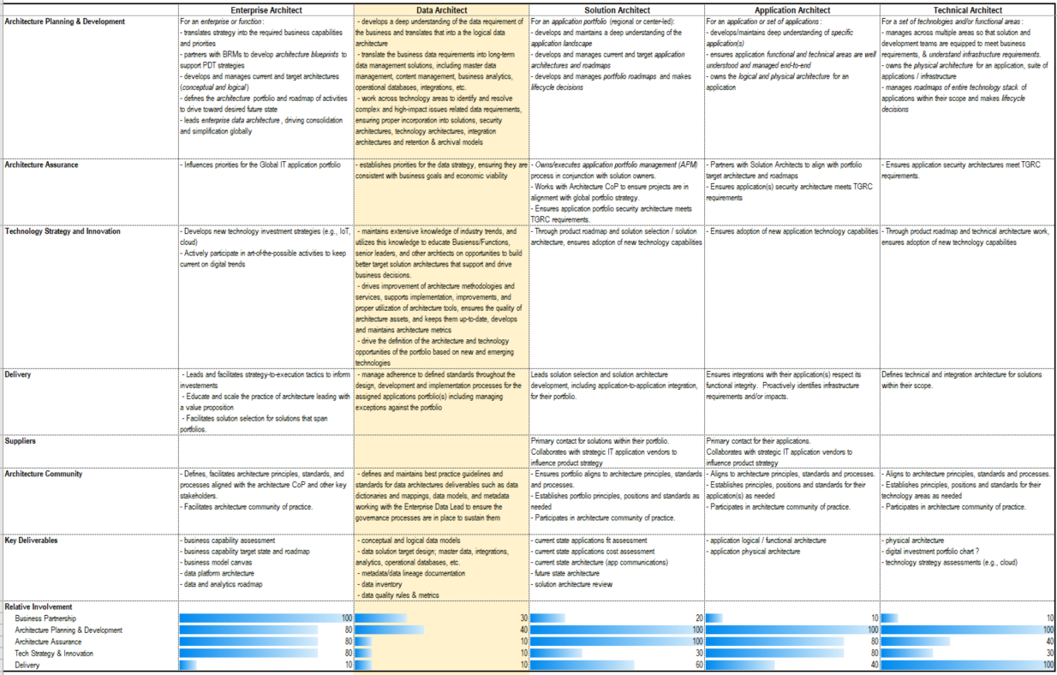
Architecture Roles
Global IT Architecture Roles

Slide 18
Position Description Summary
Data Architect

Slide 19
Position Purpose & Summary
The Data Architect supports the comprehensive architecture, functionality, economics, and architecture compliance of the Enterprise data solution. This position works closely with the Enterprise Data and Analytics Lead to bring data architecture principles that enables the overall data and analytics strategy for the Enterprise. In addition, the position will work closely with Enterprise Architects, Solution Architects, Application Architects, and key stakeholders to ensure the principles and strategic data architecture is being followed.
This role brings a holistic perspective of data architecture and data modeling with data asset management considerations. This position brings the skill in logical data modeling, physical data modeling, data policies development, quality assurance, big data warehousing, data querying languages, tools and techniques that is best for addressing data storage, retrieval and management.
Specific Responsibilities
Develops the Enterprise/FU policies on:
Logical Data Models and Integration models
Data Domains (templates for things such as passwords, addresses that makes integration easier with fields the same types and lengths)
Data Storage / architecture principals (e.g. Data Masking, Testing, etc.)
Addresses data security and privacy principles for the Enterprise
Data Harmonization Approach for Enterprise applications
Metadata/Lineage: Full map of what Data is in Enterprise data solutions (e.g. Hadoop (Data lake))
Manage Data Inventory

Slide 20
Principal Accountabilities
70% Strategic Data Architecture
Design the logical data architecture for the Enterprise
Analyze and define enterprise master data management integration strategies and models.
Translate requirements into long-term information architecture and data management solutions.
Define and maintain best practice guidelines and standards for data dictionaries and mappings, data models, and metadata working with the Enterprise Data and Analytics Lead to ensure the governance processes are in place to sustain them.
Lifecycle of data including retention models and achieve meeting RIM requirements.
Manage adherence to defined standards throughout the design, development and implementation processes for the assigned applications portfolio(s) including managing exceptions against the portfolio.
Work across technology areas to identify and resolve complex and high-impact issues related to the inter-dependencies between systems on major projects.
Provides subject matter expertise to design, develop, assess and implement complex architecture solutions (integrated process, applications, data and technology) for business problems in alignment with the assigned applications Solution Architecture direction and standards.
15% Business Partnership
Work with Business Partnering organization to advise on end to end solution feasibility at the ideation stage.
Communicating the data architecture and benefits across the Enterprise
Work to establish clear connections between business goals and strategies and the process, data, and technology investments required to achieve them.
Provide consultation and recommendations for business data needs, value chains, information integration, data quality rules, and data management requirements and/or interfaces during the design and ongoing care of solutions.
Assist in the definition of the architecture and technology opportunities of the portfolio based on new and emerging technologies.
Independently establish priorities and strategies, ensuring they are consistent with business goals and economic viability.
15% Data Innovation
Maintains extensive knowledge of industry trends, and utilizes this knowledge to educate Business/Functions, senior leaders, and other architects on opportunities to build better target data architectures that support and drive business decisions.
Drives improvement of architecture methodologies and services. Supports implementation, improvements, and proper utilization of architecture tools. Ensures the quality of architecture assets, and keeps them up-to-date. Develops and maintains architecture metrics.
Drive the definition of the architecture and technology opportunities of the portfolio based on new and emerging technologies.

Slide 21
Education, Experience, Skills
Minimum Required Qualifications
Bachelor’s degree in Business Administration, Computer Science or Management Information Systems
10 years business experience with diverse strategy, operational, development, and technology roles
5 years experience in enterprise data modeling, meta-data modeling, database design, XML schema design and information architecture practices
3 years experience in Big Data technologies and modeling practices
Experience as a full stack architect with experience in Big Data and knowledgeable of Data Models.
Experience leading technology projects in developing integrated solutions involving process, data, and technology
Strong conceptual, strategic thinking, problem solving, technical and analytical skills
Leadership and interpersonal skills including teamwork, facilitation and negotiation
Ability to influence peers and leadership stakeholders
Strong written and verbal communication skills
Proven ability to work effectively within a large organization that operates using matrix management structures
Knowledge and ability to support: translation of business needs into data architecture requirements, application of multiple technical solutions to business problems, and estimation of the financial impact of data architecture alternatives
Demonstrated ability to work in a complex environment with often conflicting priorities
Ability to quickly comprehend the functions and capabilities of new technologies
Ability to travel, including internationally, up to 20%
Business fluency in English
Preferred Qualifications
Experience as a full stack architect with experience in Open source technologies
Industry certification (Examples include ITIL, APICS, six sigma, etc.) Experience with business process design
Experience with mergers, acquisitions, and divestitures
Experience in information security schema modeling and design
Experience with database and operating system design
Demonstrated ability in performance tuning methodologies, capacity planning, release management, monitoring and reporting processes.

